Slide 1



Starting Now
Using Causal AI to Measure the Business Impact of GenAI
Causal AI is essential to drive an evidence-based GenAI deployment
Causal Forest allows to uncover the Heterogeneous Treatment Effect and optimize
Causal thinking prevent Type III error when deploying GenAI tools
Quentin Gallea, Ph.D
Founder, Advisor and Lecturer

Slide 2

Evidence-based GenAI deployment
Using Causal AI to Measure the Business Impact of GenAI

Slide 3
About Dr. Quentin Gallea
With deep expertise and a passion for causality, Dr. Quentin Gallea has published research in top journals, addressing timely issues like the effects of COVID lockdowns or weapon imports on conflict.
He is known for his unique ability to make complex topics accessible without compromising rigor.
His practical approach has empowered over 15,000 people from C-suites to experienced researchers to apply causal thinking and causal inference in their respective fields.
Today, Quentin is self employed and provides advisory, training, public speaking and advisory across the world with a particular focus on measuring the impact of AI.
In addition, he is a Senior Advisor at Enlighten Advisory, offering his expertise to support strategic decisions.
Quentin Gallea, Ph.D
Founder, Advisor and Lecturer

Slide 4
Agenda
01
The million-dollar question
02
Why Causal AI?
03
Before: Causal evidence
04
During: Causal Forest
05
After: Type III Error
06
What is next?

Slide 5
Section [01]:
The million-dollar question

Slide 6
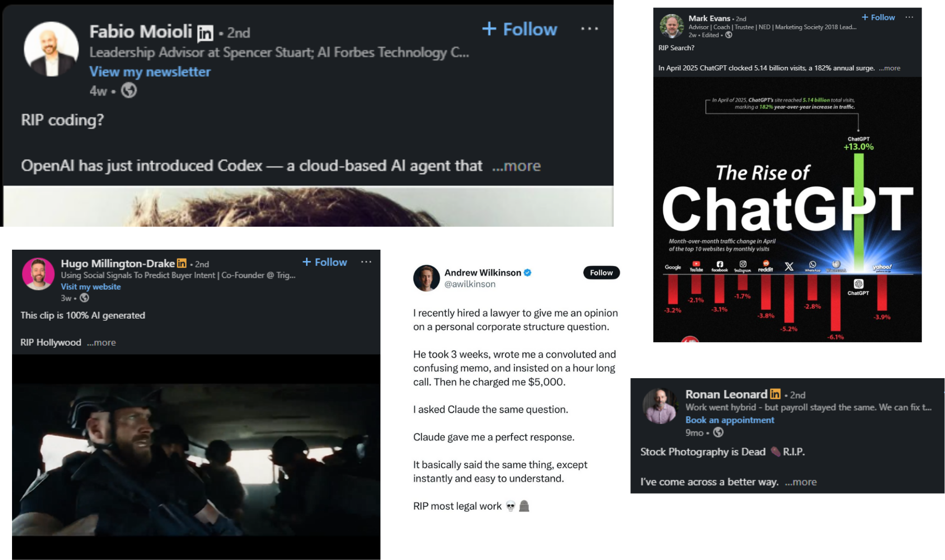
The million-dollar question
>
Pg: 6
Notes:
On one hand, GenAI seems to be a revolution, destroying jobs and everything we know.

Slide 7
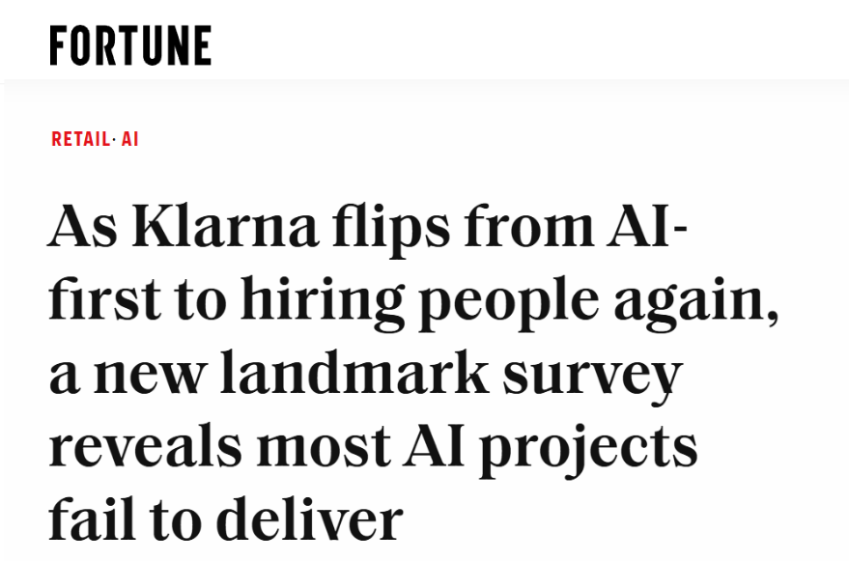
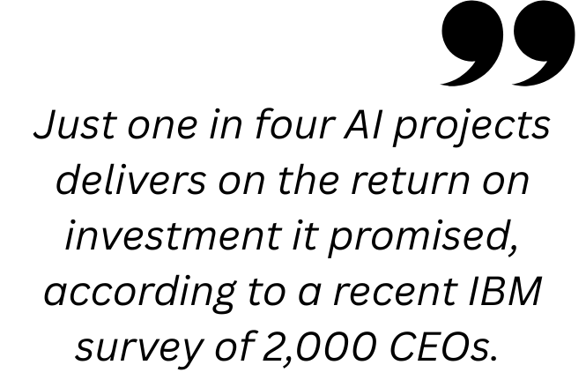
The million-dollar question
>
Pg: 7
Notes:
On one hand, GenAI seems to be a revolution, destroying jobs and everything we know.

Slide 8
How do we actually know what works and what doesn’t?
Notes:
We need Causal inference and causal AI

Slide 9
Section [02]: Why Causal AI?

Slide 10

Why Causal AI?
What is Predictive Inference?
Predictive inference aims to answer what is the potential value of something when we observe something else.
“Traditional” AI (Machine/Deep Learning) is NOT made for causal estimation.
“Traditional” AI (Machine/Deep Learning) is made for prediction.
>
Pg: 10
Notes:
The role of Causal inference is two-fold: understand cause and consequences.

Slide 11
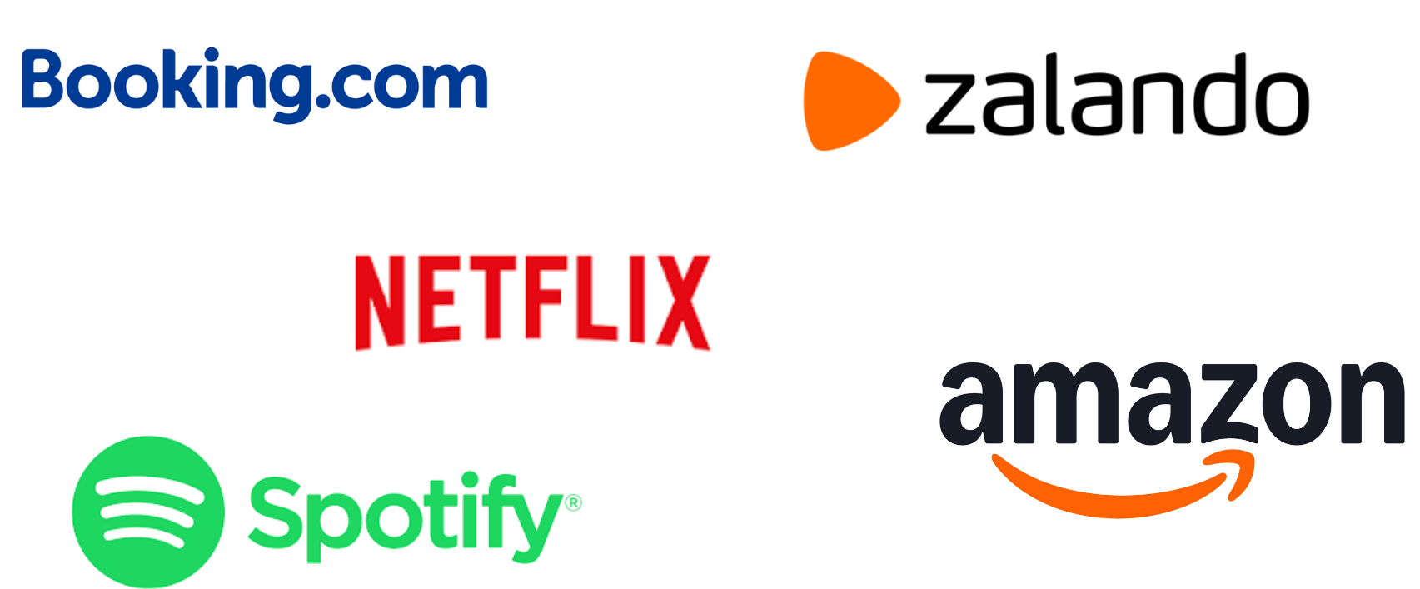
Why Causal AI?
>
Pg: 11
Notes:
Exactly what these companies are doing. You can use to test GenAI tools against traditional method (e.g. customer service) or to optimize, new vs old model.

Slide 12
Why Causal AI?
What is Causal Inference?
The science and set of tools used to measure and identify true cause-and-effect relationships, separating them from simple correlations or coincidences.
You need causal inference if you want to measure impact, understand effects and causal relationships.
?
>
Pg: 12
Notes:
The role of Causal inference is two-fold: understand cause and consequences.

Slide 13
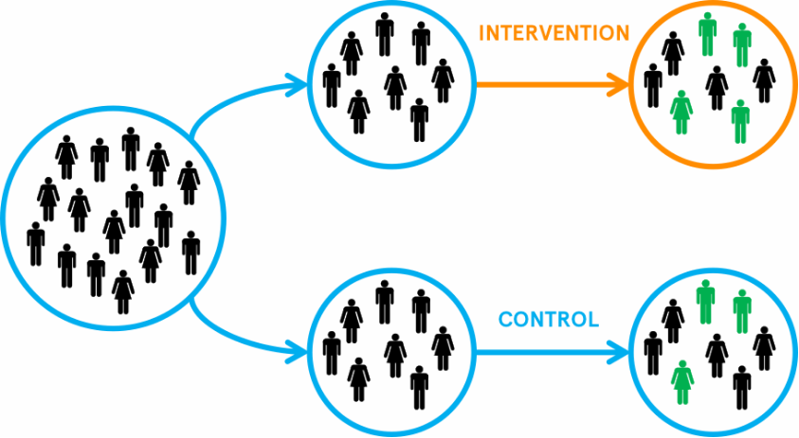
Why Causal AI?
What is Causal Inference?
>
Pg: 13
Notes:
The role of Causal inference is two-fold: understand cause and consequences.

Slide 14
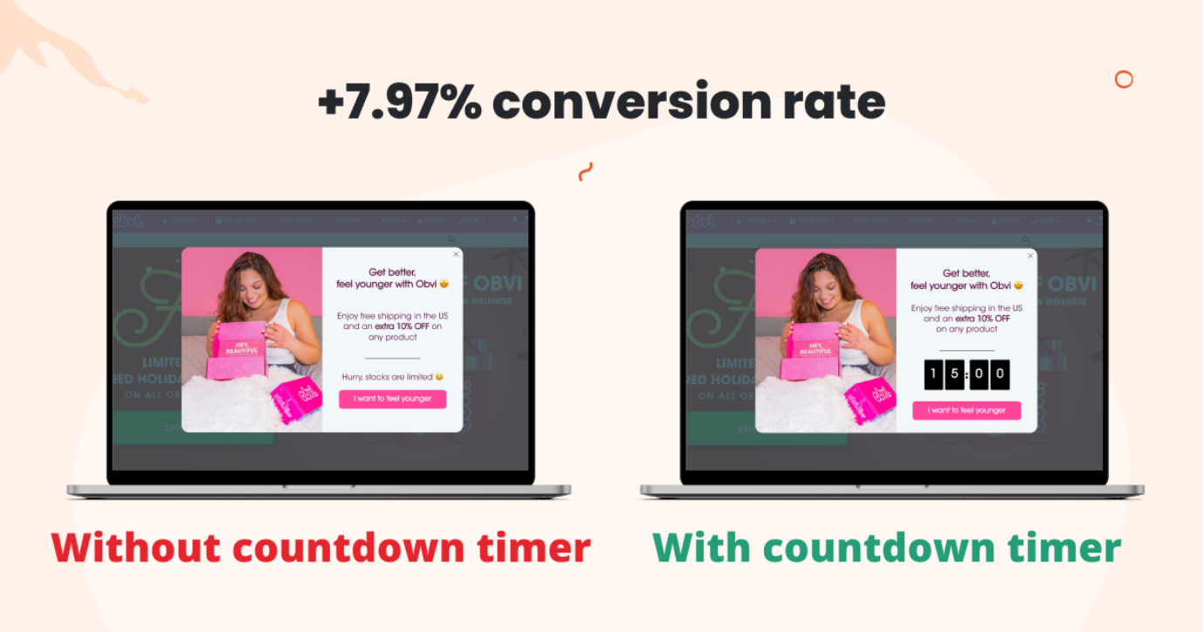
Why Causal AI?
What is Causal Inference?
>
Pg: 14
Notes:
The role of Causal inference is two-fold: understand cause and consequences.

Slide 15



Why Causal AI?
What is the impact of our AI model in production?
AI tools
>
Pg: 15
Notes:
This is the framework to assess the business impact of AI used by top tech companies

Slide 16

Why Causal AI?
What is the impact of our AI model in production?
Prediction quality metrics are not the answer.
Use Causal Inference to measure the business impact of AI.
AI tools
Causal Inference
(e.g.A/B testing)
Business impact
>
Pg: 16
Notes:
This is the framework to assess the business impact of AI used by top tech companies

Slide 17
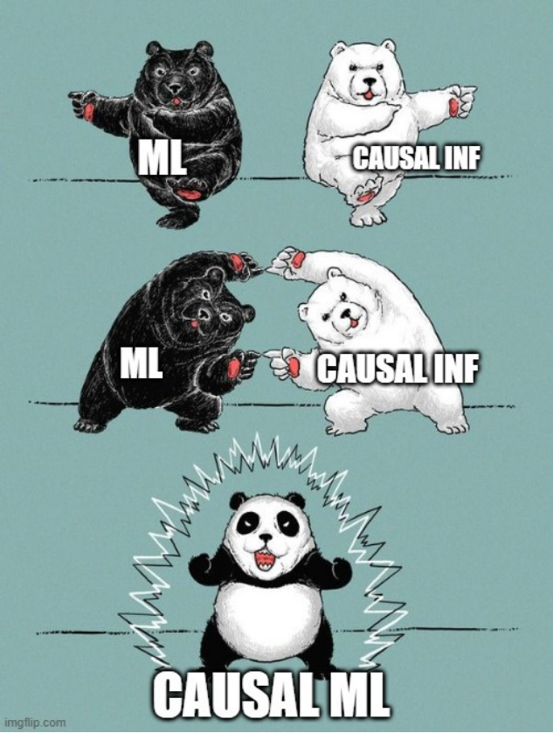
Why Causal AI?
What is Causal AI?
Causal AI is a set of tools within causal inference exploiting AI, in particular Machine Learning, to support specific sub-tasks such as uncovering heterogeneous treatment effects, dealing with complex functions and also leveraging the domain knowledge from Generative AI.
>
Pg: 17

Slide 18
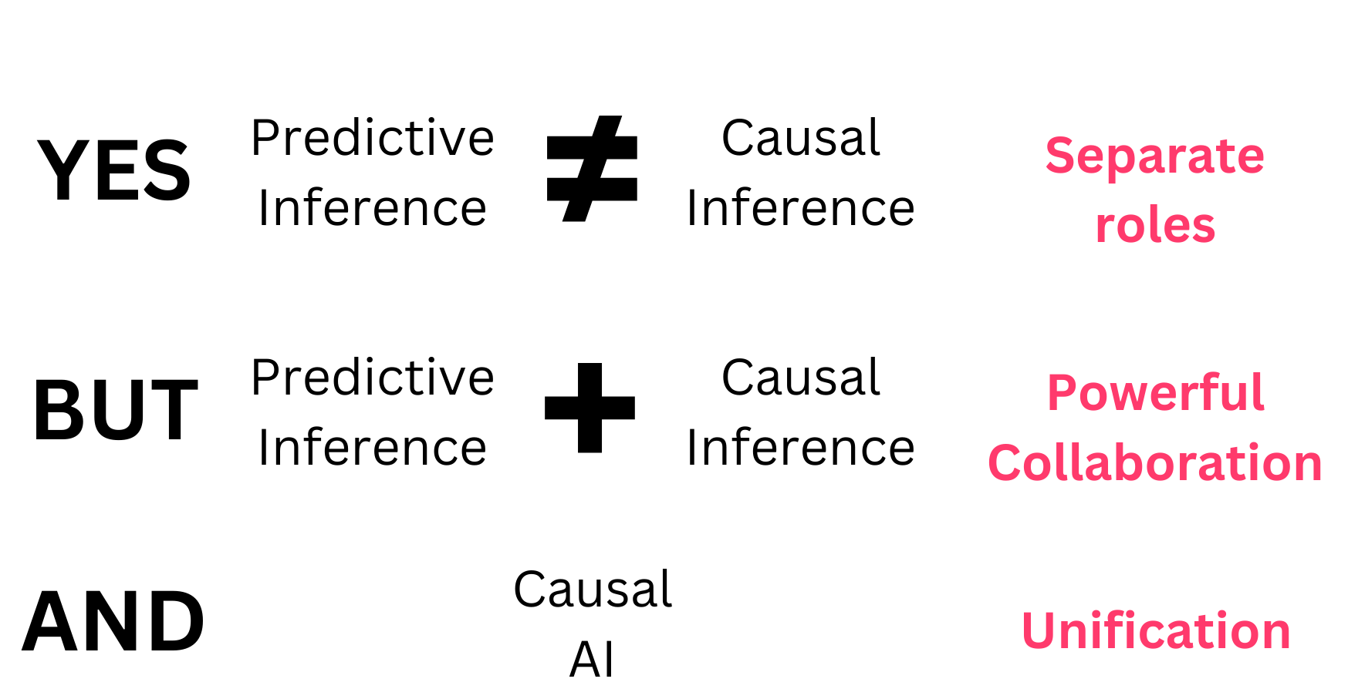
Why Causal AI?
>
Pg: 18

Slide 19
Section [03]:
Before implementation:
Causal Evidence
Notes:
Now, let’s dive into the main application of Causal AI that you can use in your organisation

Slide 20
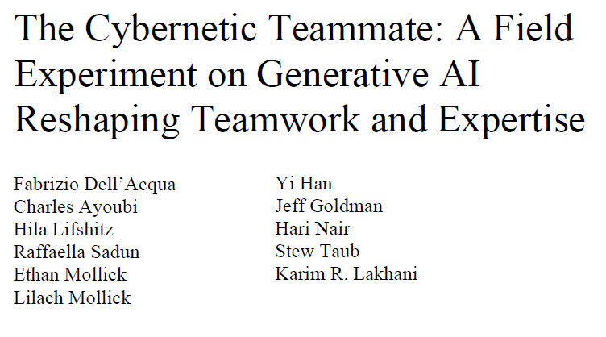
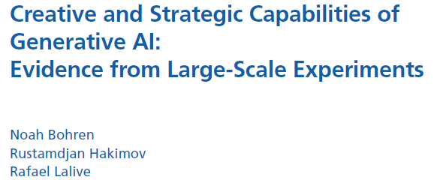
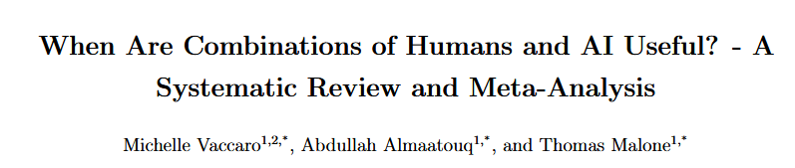
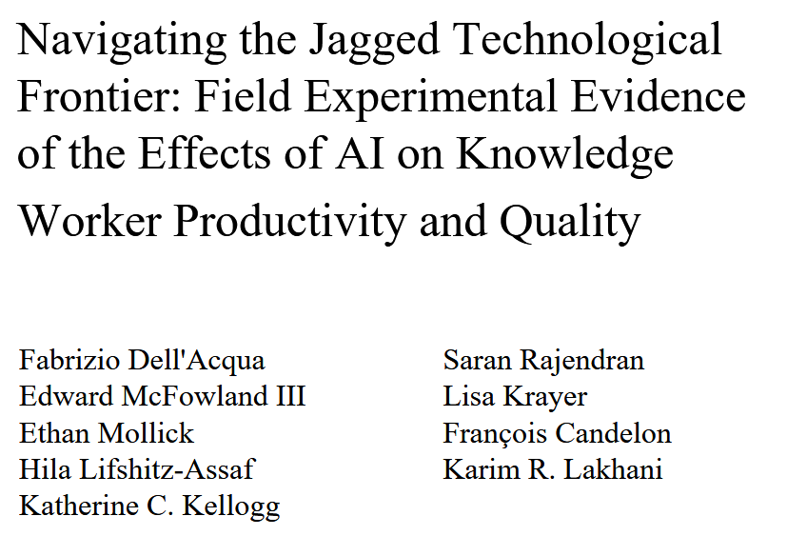
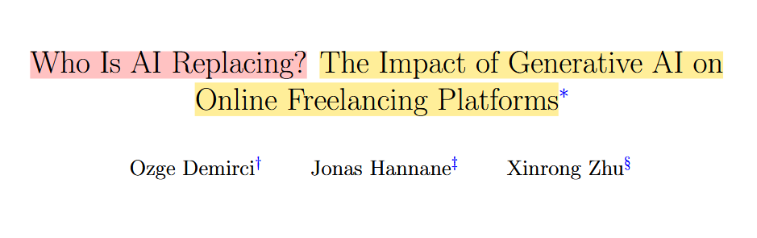
Why Causal AI?
>
Pg: 20
Notes:
In addition, causal evidence from research helps to pile up. reliable evidence on what works and what doesn’t

Slide 21
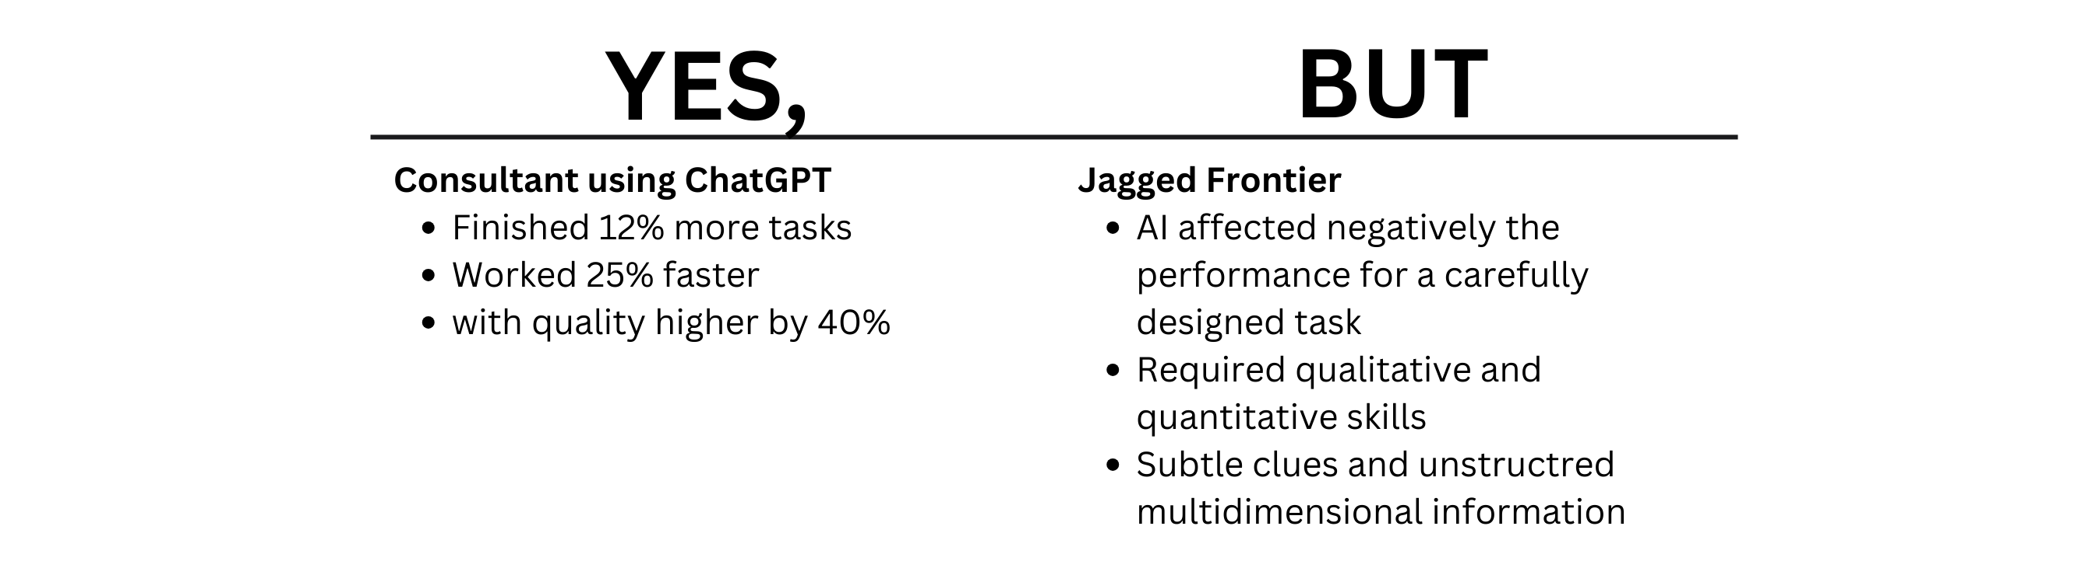
Why Causal AI?
>
Pg: 21
Notes:
Strawberry example

Slide 22
Why Causal AI?
>
Pg: 22
Notes:
Strawberry example

Slide 23
Section [04]:
During implementation:
Causal Forest
Notes:
Now, let’s dive into the main application of Causal AI that you can use in your organisation

Slide 24
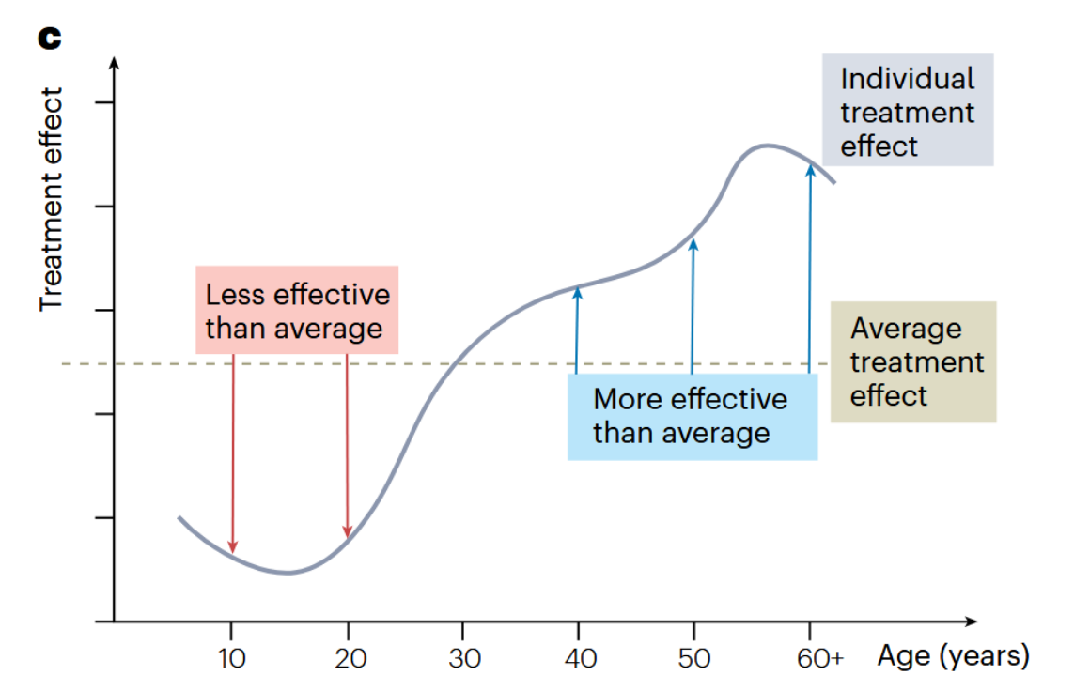
Causal Forest
Beyond Average Treatment Effects
Source: Causal machine learning for predicting treatment outcomes
https://www.nature.com/articles/s41591-024-02902-1
>
Pg: 24

Slide 25
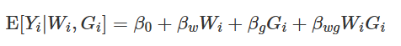
Causal Forest
Naive Approach
Split based on different variables
Where W is your treatment variable, and G is some binary variable representing a Group (e.g. Mobile users).
Limitation: There are often numerous possibilities:
Complex,
P-hacking,
Multiple testing issue
>
Pg: 25

Slide 26
Causal Forest
Better Approach: Causal Tree or Causal Forest
Two step approach:
Randomized Experiment (A/B testing) with observed covariates
Use Causal Tree or Forest on the results to capture the HTE
>
Pg: 26

Slide 27
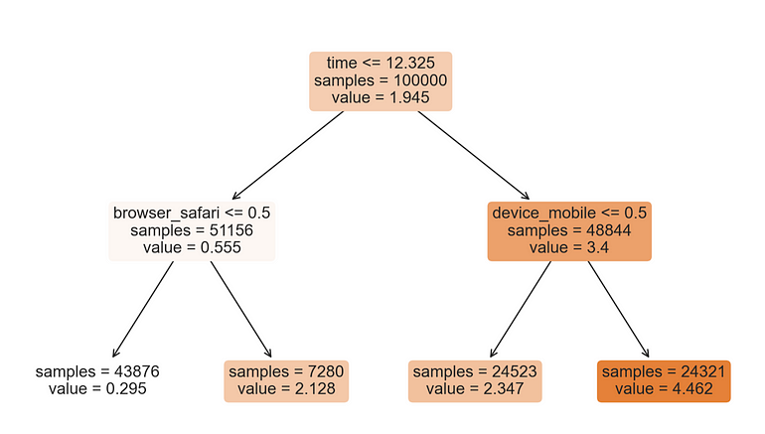
Causal Forest
Beyond Average Treatment Effects
Example:
Online shop and we are interested in understanding whether GenAI chatbot answering question expenditure
Source: Understanding Causal Trees By Matteo Courthoud
https://medium.com/towards-data-science/understanding-causal-trees-920177462149
>
Pg: 27

Slide 28
Section [04]:
After implementation:
Type III error

Slide 29

Type III error
Causal Inference can be misleading
Type III error: Answering correctly the wrong question.
Imgflip.com
>
Pg: 29
Notes:
A common issue that I witness in my practice.

Slide 30
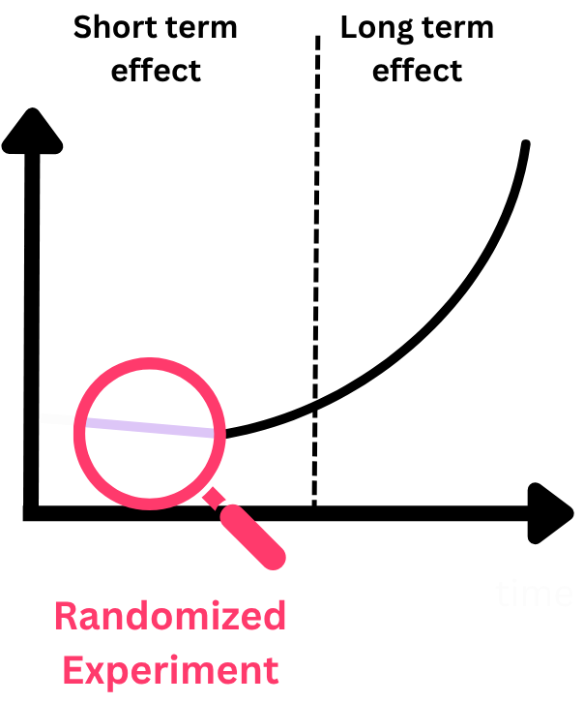
Type III error
Misleading Extrapolation
>
Pg: 30

Slide 31
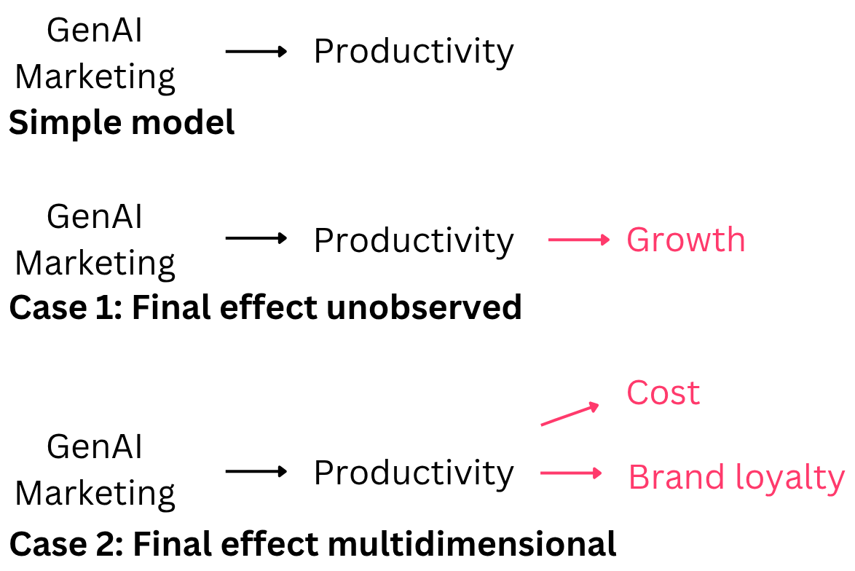
Type III error
Misleading Extrapolation
>
Pg: 31

Slide 32
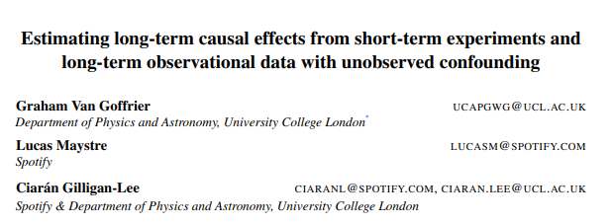
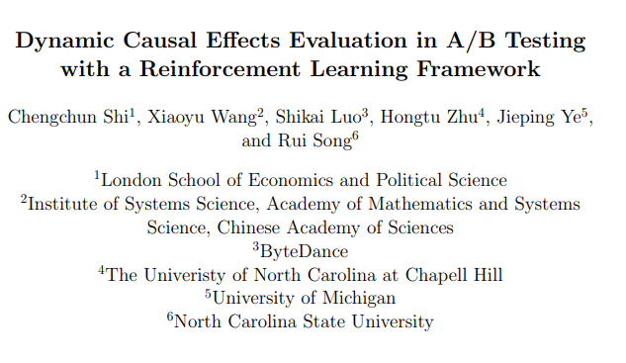
Type III error
Solutions
“Simplicity is the ultimate sophistication”
1. Most of the time, selecting a set of metrics to avoid blind spots is enough.
Think about what could go wrong (multidimensional, short vs long term) and identify metrics that would capture these effects.
2. Include long term old-out group.
3. Use quasi-experimental methods (e.g. Diff-in-Diff)
More Technical
>
Pg: 32
Notes:
You have more or less technical answers. Cutting edge research provide potential solutions, but often simply reflecting on what can go wrong and tracking multiple metrics will do most of the job.

Slide 33
Section [05]: What is next?

Slide 34
What is next?
Overview
Study causal evidence from reliable scientific research
Acquire awareness of potential of GenAI, limitations and dangers
Use A/B testing and Causal Forest to measure the effect and optimize
Reflect on the potential impact and how the right metrics to measure before deployment of GenAI
What can go wrong (Type III error)?
>
Pg: 34
Notes:
The role of Causal inference is two-fold: understand cause and consequences.

Slide 35
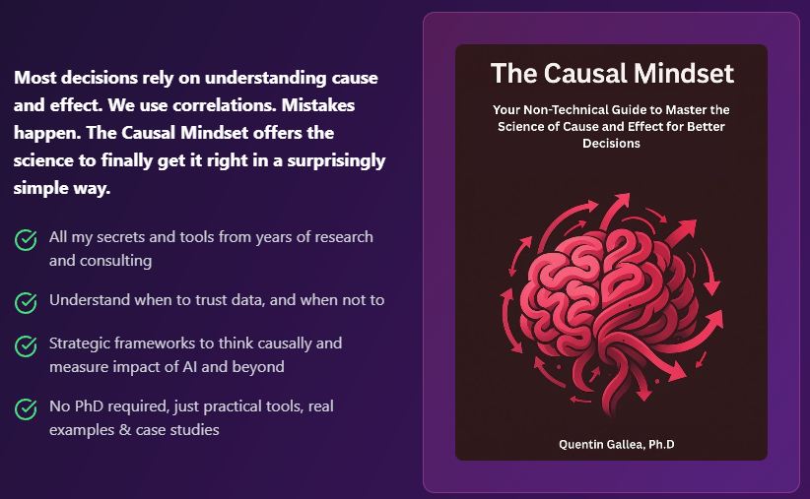
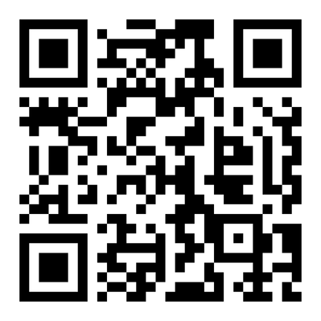
What is next?
My forthcoming book with Packt
quentingallea.com/book
>
Pg: 35

Slide 36
What is next?
Free online resources
How to learn Causal Inference on Your Own for Free
https://medium.com/towards-data-science/how-to-learn-causal-inference-on-your-own-for-free-98503abc0a06
Understanding Causal Trees
https://medium.com/data-science/understanding-causal-trees-920177462149
Machine Learning & Causal Inference: A Short Course
https://www.gsb.stanford.edu/faculty-research/labs-initiatives/sil/research/methods/ai-machine-learning/short-course
Causal ML book (Double Machine Learning) https://causalml-book.org/
>
Pg: 36

Slide 37
Thank you.
Any questions?

